Slide 1




HR Data Attrition Analysis Source: : https://www.kaggle.com/datasets/pavansubhasht/ibm-hr-analytics-attrition-dataset Dataset: HR-Employee-Attrition.csv Email: mundrikatejasrichinnu@gmail.com Phone : 8179446857 LinkedIn : www.linkedin.com/in/tejasri-mundrika
HR Data Attrition Analysis Using PySpark
Mundrika Tejasri

Slide 2
Introduction
Human Resource analytics has become an essential tool for organizations aiming to understand workforce behavior and improve decision-making. By analyzing employee-related data, companies can uncover patterns in demographics, compensation, performance, and attrition, which in turn support strategic planning and talent management.
This report analyzes the HR Employee Attrition dataset, which contains detailed information on employee demographics, job roles, compensation, and satisfaction metrics. The goal is to identify key workforce trends, highlight potential risk factors for attrition, and provide actionable recommendations that can enhance employee retention, optimize compensation policies, and strengthen organizational stability.

Slide 3
Initial Analysis of the Dataset
The dataset contains records of 1,470 employees across 35 variables, capturing demographic, job-related, and compensation details along with attrition status. The absence of missing values ensures reliability for analysis
1. Company Workforce Snapshot
The dataset represents 1,470 employees.
Departments: Research & Development, Sales, and Human Resources.
Research & Development is the largest group.
Sales is the second largest.
Human Resources is the smallest.
This reflects an organization with strong emphasis on R&D and client-facing roles.
2. Employee Demographics
Age: Employees range between 18 and 60 years.
Average age ~37 years.
50% of employees fall between 30 and 43 years.
Gender and Marital Status: Balanced mix of male and female employees, with representation across single, married, and divorced groups.
Education Field: Six main streams including Life Sciences, Medical, Marketing, and Technical backgrounds, ensuring diverse skill sets.

Slide 4
Initial Analysis of the Dataset
3. Roles and Career Progression
Job Roles: 9 distinct categories, such as Laboratory Technician, Sales Executive, Research Scientist, and Manager.
Job Levels: Range from 1 (entry level) to 5 (executive level).
Experience:
Average total working experience ~11 years.
Average tenure at the company ~7 years.
Some employees are freshers, while others have as many as 40 years of experience.
4. Compensation and Benefits
Monthly Income:
Range: 1,009 – 19,999.
Average: ~6,500.
Senior roles and higher job levels show significantly higher pay.
Salary Hikes: Percent increases between 11% and 25%, averaging ~15%.
Stock Options: Levels range from 0 to 3, showing varying access to long-term incentives.

Slide 5
Initial Analysis of the Dataset
5. Work Environment and Engagement
Satisfaction Measures: Job Satisfaction, Relationship Satisfaction, Work-Life Balance, and Environment Satisfaction are all rated on 1–4 scales.
Most employees report moderate-to-high satisfaction.
Overtime: Employees working overtime are more prone to attrition, a key insight for HR planning.
6. Attrition Trends
Attrition Rate: About 16% of employees have left the company.
Key Risk Areas:
Sales and overtime-heavy roles show higher attrition.
Younger employees and those with fewer years at the company are more likely to leave.
Attrition is linked with workload, compensation growth, and role type.

Slide 6
Initial Analysis of the Dataset
7. Training and Development
Training Frequency: Employees underwent between 0–6 training programs in the last year.
Average: ~3 training sessions per employee.
Training appears balanced but may vary depending on department and role.
Continuous development opportunities can play a role in improving retention and satisfaction.
8. Managerial and Promotion Insights
YearsWithCurrManager: Average ~4 years, with a range of 0–17.
Promotions:
Measured by YearsSinceLastPromotion, averaging ~2 years.
Many employees had recent promotions, but some have waited longer, which could influence morale.
Managerial stability and timely promotions may be critical to employee engagement and retention.

Slide 7
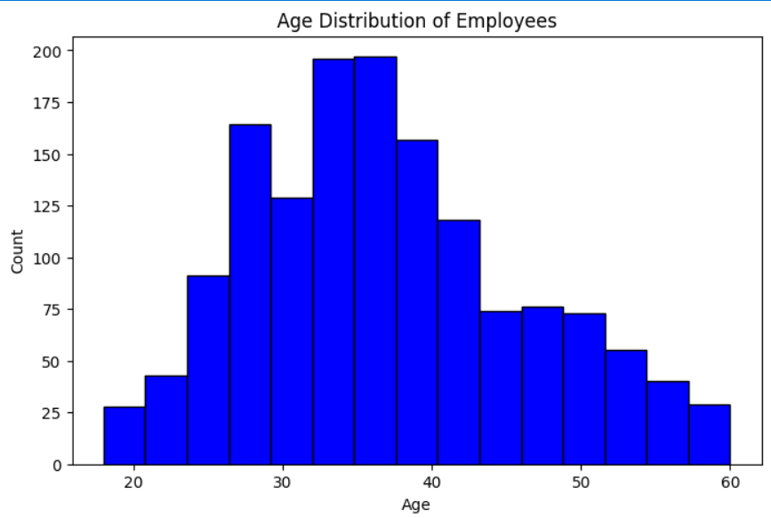
Age Distribution Of Employees
The age distribution shows that most employees are between 30 and 40 years, indicating a mid-career dominant workforce. Fewer employees are under 25 or above 50, reflecting limited entry-level and senior-level representation.

Slide 8
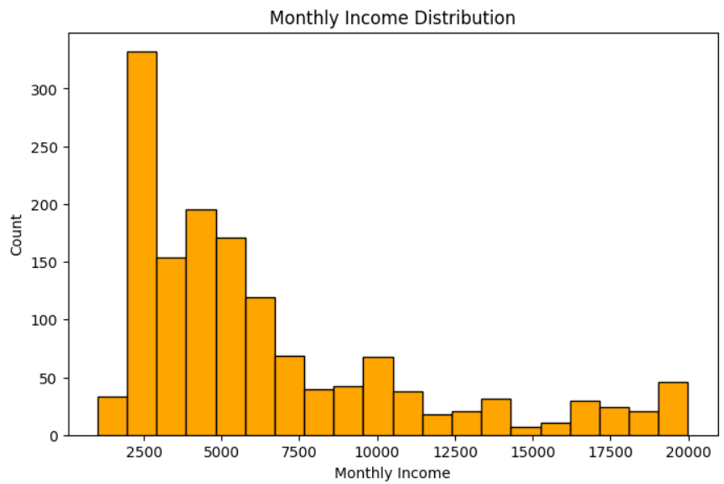
Monthly Income Distribution
This histogram shows the monthly income distribution of employees. Most employees earn between 2,000 and 5,000, with the highest concentration around 2,500. As income increases, the number of employees gradually decreases, showing fewer high earners. A small group earns above 15,000–20,000, likely representing senior or executive-level positions.

Slide 9
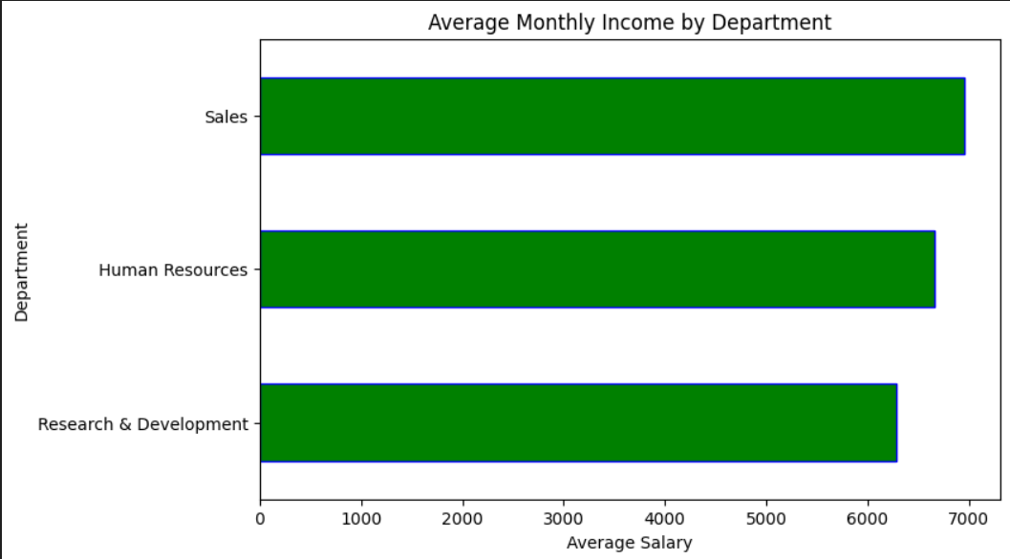
Average Monthly Income by Department
The chart compares the average monthly income across departments. Sales employees have the highest average income, close to 7,000. Human Resources follows closely with slightly lower income levels. Research & Development employees earn the least on average, though still within a competitive range.

Slide 10
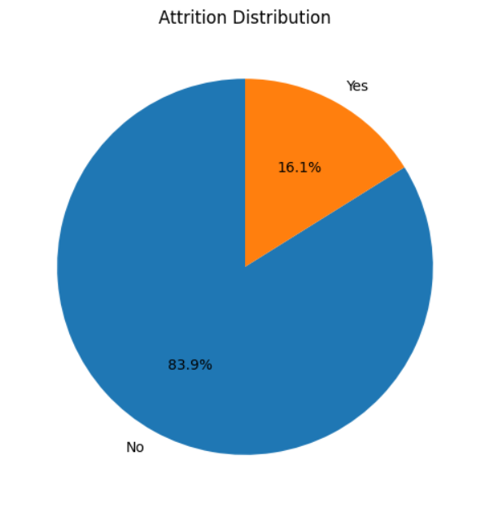
Attrition Distribution
The pie chart displays the "Attrition Distribution," illustrating the proportion of individuals who have experienced attrition ("Yes") versus those who have not ("No").
No: The larger segment, representing 83.9%, indicates that the majority of individuals have not experienced attrition.
Yes: The smaller segment, representing 16.1%, indicates that a notable percentage of individuals have experienced attrition.
This visualization clearly shows that the rate of attrition is significantly lower than the rate of non-attrition within the dataset represented.

Slide 11
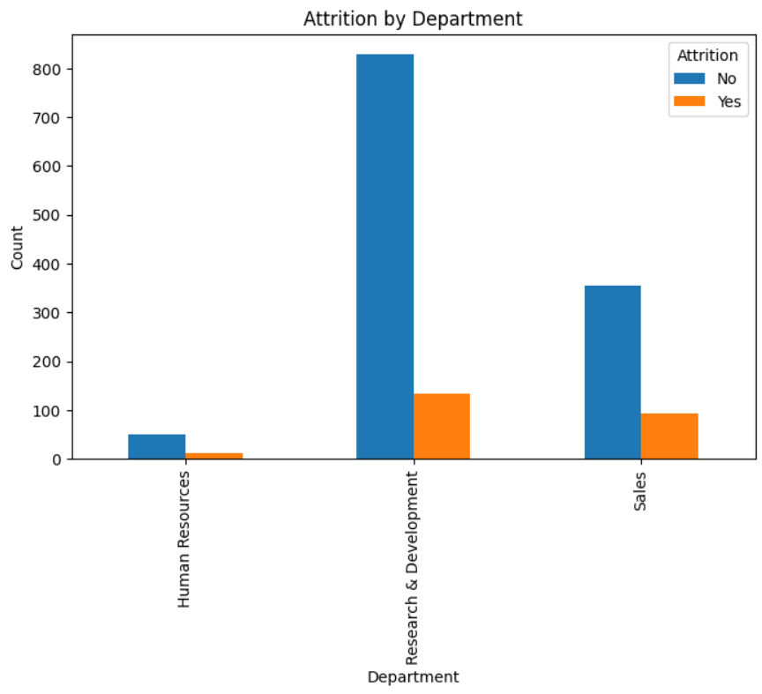
Attrition By Department
This bar chart illustrates employee attrition across three departments: Human Resources, Research & Development, and Sales. The Research & Development department has the highest number of employees, both attriting and non-attriting, indicating a large workforce. Conversely, Human Resources shows the lowest employee count and the lowest attrition figures among the departments.

Slide 12
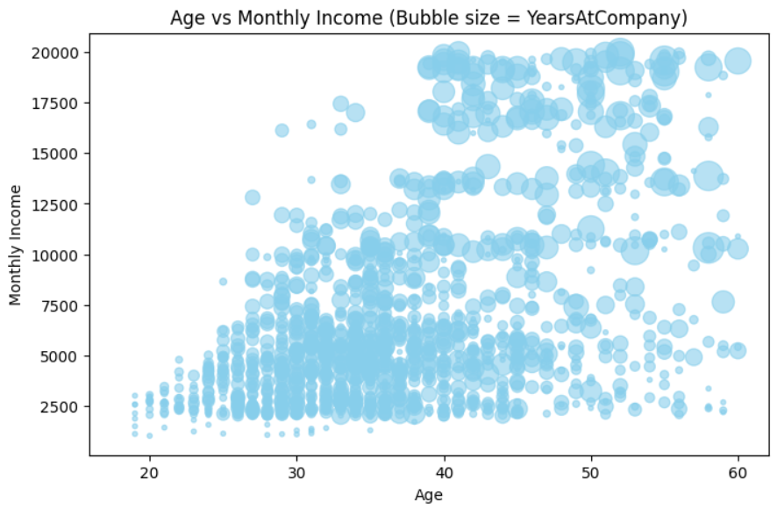
Age vs Monthly Income
This bubble chart visualizes the relationship between Age and Monthly Income, where each bubble represents an individual. The size of each bubble indicates the number of YearsAtCompany, showing how tenure relates to age and income. Generally, older individuals and those with more years at the company tend to have higher monthly incomes.

Slide 13
Dataset Observation
Workforce Age Profile
The employee base is largely composed of individuals in their 30s, representing a strong mid-career workforce. Younger professionals (20s) form a significant share, indicating fresh recruitment and early-career presence. Older employees (50+) are fewer, showing limited late-career representation.
Compensation Structure
Most employees fall into moderate income levels, aligning with junior and mid-level roles. A smaller segment earns at the higher end, reflecting senior positions or specialized roles. Compensation differences exist between departments, influenced by role-specific demands.
Increment & Rewards Pattern
Annual salary hikes typically cluster between 11–15%, suggesting a standard increment policy. Certain employees benefit from higher hikes, likely due to performance or strategic importance. This mix highlights both uniform and performance-driven reward systems.

Slide 14
Dataset Observation
Departmental Composition
Research & Development forms the largest share of staff, showing its critical role in operations. Sales teams are comparatively smaller but strategically vital for business growth. Human Resources remains lean, serving as a support and compliance function. Compensation patterns vary across departments, reflecting their functional impact.
Employee Turnover Insights
Attrition is more pronounced among younger staff and those with higher travel or overtime commitments. Early-career employees show greater movement, while mid-to-senior employees are more stable. This suggests retention challenges in balancing workload and career expectations.
Work-Life & Location Factors
Employees living closer to the workplace form a larger portion of the workforce. Work-life balance scores are moderate overall, though overtime employees tend to report lower satisfaction. Location and work-life policies appear to influence retention trends.

Slide 15
Conclusion
The dataset provides a comprehensive view of a mid-sized organization with a strong focus on Research & Development and Sales functions. The workforce is predominantly mid-career, with employees averaging 37 years of age and showing a healthy mix of experience levels. Compensation practices, including salaries and salary hikes, demonstrate structured growth aligned with job levels and tenure, though significant variation exists due to executive-level outliers.
Employee satisfaction indicators such as job satisfaction, work-life balance, and relationship satisfaction are generally positive, yet attrition remains a concern, particularly among younger employees, sales roles, and those working overtime. Training opportunities and promotion patterns highlight areas where career development strategies could further strengthen retention.
Overall, the dataset is highly suitable for HR analytics, workforce planning, and attrition prediction models. Insights derived from this data can guide management in improving retention strategies, refining promotion policies, and ensuring long-term organizational stability.

